Slide 1
Independent component analysis

Slide 2
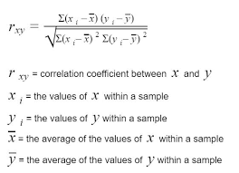
Independent component analysis
Principle component: Correlation between random variables
Independent : Independent that means
P(XY)=P(X).P(Y)
Two pressure
overlap
Sound
Wave
Pressure on air, other subsatance
Addition
Independent
Corelation zero
Dependent (Non-linear)
Zero (corelation)
Independent
Non-zero

Slide 3




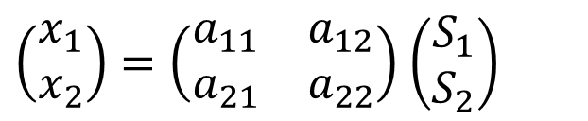




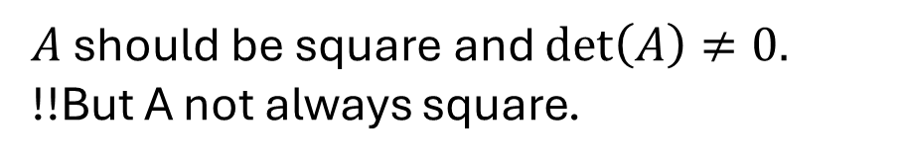




Independent component analysis
$$S_{1}$$
$$a_{11}$$
$$X_{1}$$
$S_{1}a_{11}$ $+S_{2} a_{21}=X_{1}$
$$a_{21}$$
$$a_{12}$$
$$S_{1}=[s_{11} s_{12}, …., s_{1N}]$$
$$S_{2}$$
$$a_{22}$$
$$X_{2}$$
$$X=AS$$
$A$ should be square and $\det\left(A\right)≠0.$
!!But A not always square.
$$S=A^{−1}X$$
Our first interest is to separate the source !
$\left(\begin{matrix}x_{1} \\ x_{2}\end{matrix}\right)=\left(\begin{matrix}a_{11} & a_{12} \\ a_{21} & a_{22}\end{matrix}\right)$ $\left(\begin{matrix}S_{1} \\ S_{2}\end{matrix}\right)$

Slide 4

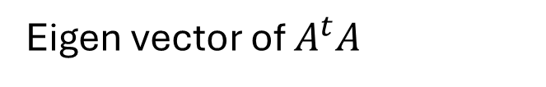
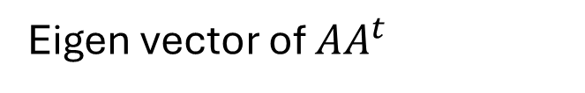
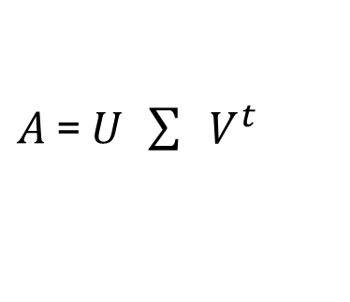
Independent component analysis
$$X=AS$$
But we know From SVD,
$A_{ }$= $U_{ } \sum{ } V_{ }^{t}$
Eigen vector of $AA_{ }^{t}$
Eigen vector of $A_{ }^{t}A$
Diagonal matrix, (square-root of eigen value)

Slide 5
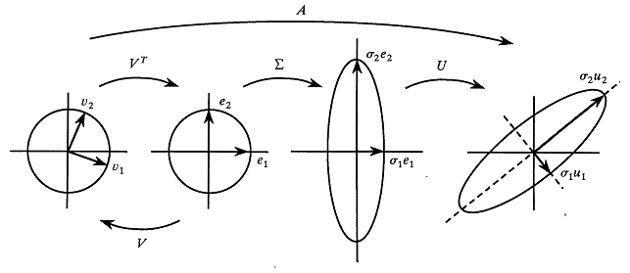
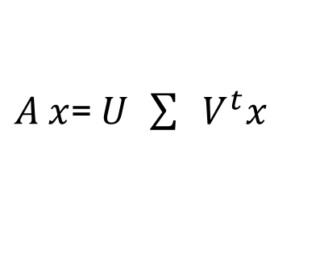


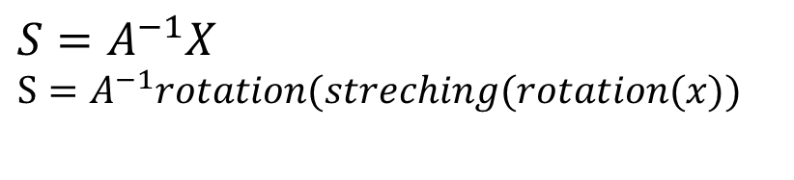


Independent component analysis
Forward
$$S=A^{−1}X$$
$$S=A^{−1}rotation(streching(rotation(x))$$
Two rotation $∅$and eigen value is unknown
$A_{ }x$= $U_{ } \sum{ } V_{ }^{t}x$
$$V^{ }$$
$$Σ^{−1}$$
$$U^{T}$$
Reverse

Slide 6
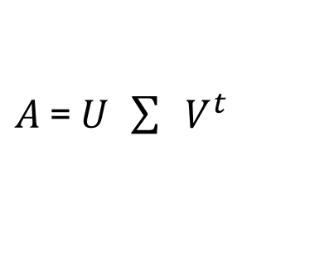


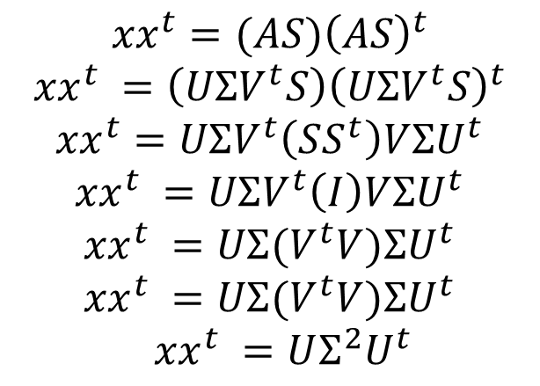
Independent component analysis
From SVD
$$x=AS$$
$${xx}^{t}=(AS{)\left(AS\right)}^{t}$$
$${xx}^{t} =\left(UΣV^{t}S\right){\left(UΣV^{t}S\right)}^{t}$$
$${xx}^{t}=UΣV^{t}\left(SS^{t}\right)V{ΣU}^{t}$$
$${xx}^{t} =UΣV^{t}\left(I\right)V{ΣU}^{t}$$
$${xx}^{t} =UΣ{(V}^{t}V){ΣU}^{t}$$
$${xx}^{t} =UΣ{(V}^{t}V){ΣU}^{t}$$
${xx}^{t} =UΣ^{2}U^{t}$
Let the source data is whitening data (S). That means, variance is 1, diagonal and correlation 0.
$A_{ }$= $U_{ } \sum{ } V_{ }^{t}$
We know, $U=AV$

Slide 7
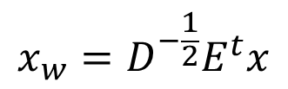




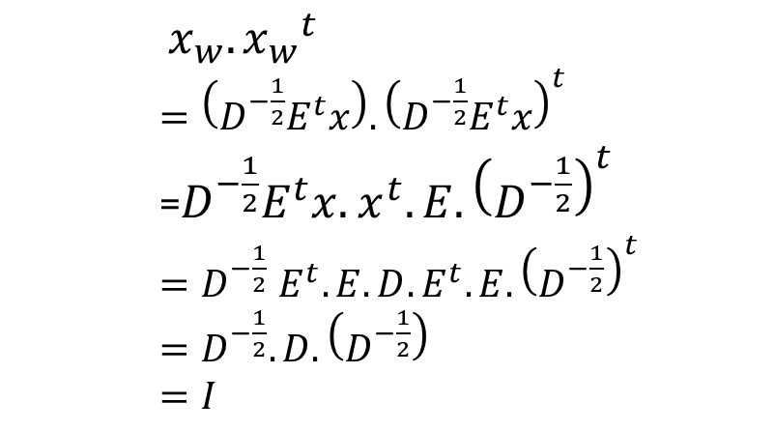
Independent component analysis
Now,
$${xx}^{t} =EDE^{t}$$
From PCA
$x_{w}.{x_{w}}^{t}$
$=\left(D^{−\frac{1}{2}}E^{t}x\right).{\left(D^{−\frac{1}{2}}E^{t}x\right)}^{t}$
=$D^{−\frac{1}{2}}E^{t}x.$ $x^{t}.E.{\left(D^{−\frac{1}{2}}\right)}^{t}$
${=D}^{−\frac{1}{2}}E^{t}.E.D.E^{t}.E.{\left(D^{−\frac{1}{2}}\right)}^{t}$
${=D}^{−\frac{1}{2}}.D.{\left(D^{−\frac{1}{2}}\right)}^{ }$
$=I$
$$x_{w}=D^{−\frac{1}{2}}E^{t}x$$
Data whitening.
Transfer into new space and then variance down to 1 and
make uncorrelate
Y
Y
Y1
Y1
X1
X1
X
X
$$x$$
$$E^{t}x$$
$$D^{−\frac{1}{2}}E^{t}x$$

Slide 8

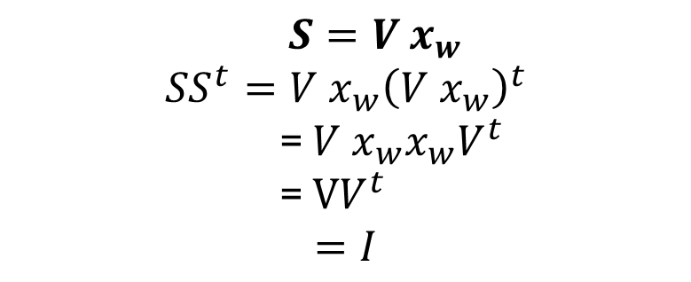

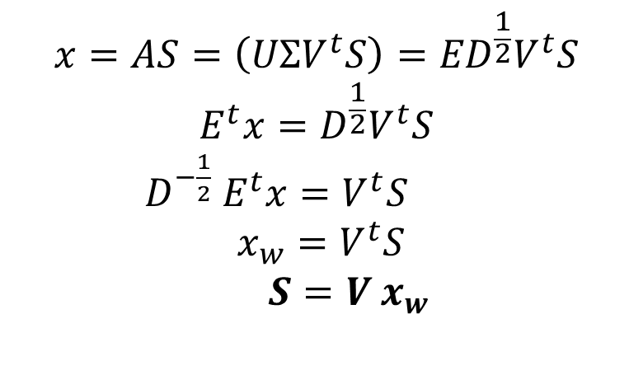


Independent component analysis
${xx}^{t} =UΣ^{2}U^{t}$
$${xx}^{t} =EDE^{t}$$
$$U=E$$
$$Σ {=D}^{\frac{1}{2}}$$
Now,
$$x=AS=\left(UΣV^{t}S\right)={ED}^{\frac{1}{2}}V^{t}S$$
$$E^{t}x={D^{\frac{1}{2}}V}^{t}S$$
$D^{−\frac{1}{2}} E^{t}x=V^{t}S$
$$x_{w}=V^{t}S$$
$S={V^{ }x}_{w}$
$S={V^{ }x}_{w}$
$${SS}^{t}={V^{ }x}_{w}{\left({V^{ }x}_{w}\right)}^{t}$$
= ${V^{ }x}_{w}x_{w}V^{t}$
= $VV^{t}$
$$=I$$
First data need to whitening
Rotational matrix
Only one unknown

Slide 9
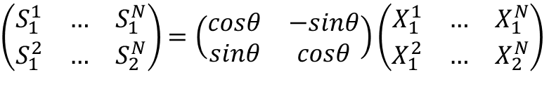
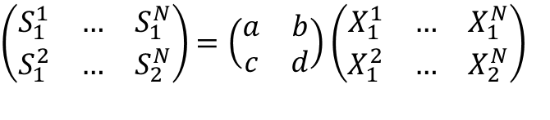
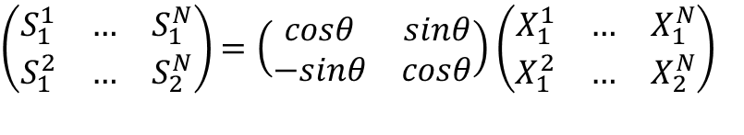
Independent component analysis
Writing as matrix
$\left(\begin{matrix}S_{1}^{1} & … & S_{1}^{N} \\ S_{1}^{2} & … & S_{2}^{N}\end{matrix}\right)$ $=\left(\begin{matrix}a & b \\ c & d\end{matrix}\right)\left(\begin{matrix}X_{1}^{1} & … & X_{1}^{N} \\ X_{1}^{2} & … & X_{2}^{N}\end{matrix}\right)$
$\left(\begin{matrix}S_{1}^{1} & … & S_{1}^{N} \\ S_{1}^{2} & … & S_{2}^{N}\end{matrix}\right)$ $=\left(\begin{matrix}cosθ & −sinθ \\ sinθ & cosθ\end{matrix}\right)\left(\begin{matrix}X_{1}^{1} & … & X_{1}^{N} \\ X_{1}^{2} & … & X_{2}^{N}\end{matrix}\right)$
Counter clock wise
$\left(\begin{matrix}S_{1}^{1} & … & S_{1}^{N} \\ S_{1}^{2} & … & S_{2}^{N}\end{matrix}\right)$ $=\left(\begin{matrix}cosθ & sinθ \\ −sinθ & cosθ\end{matrix}\right)\left(\begin{matrix}X_{1}^{1} & … & X_{1}^{N} \\ X_{1}^{2} & … & X_{2}^{N}\end{matrix}\right)$
clock wise

Slide 10
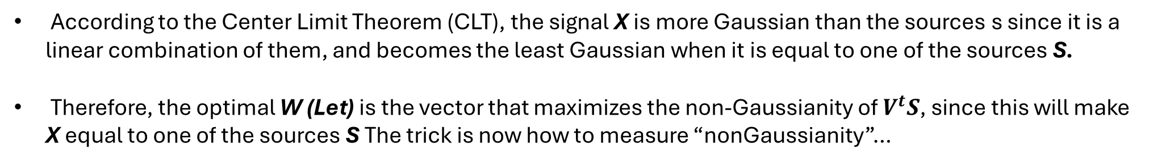
Independent component analysis
According to the Center Limit Theorem (CLT), the signal X is more Gaussian than the sources s since it is a linear combination of them, and becomes the least Gaussian when it is equal to one of the sources S.
Therefore, the optimal W (Let) is the vector that maximizes the non-Gaussianity of $V^{t}S$, since this will make X equal to one of the sources S The trick is now how to measure “nonGaussianity”…

Slide 11
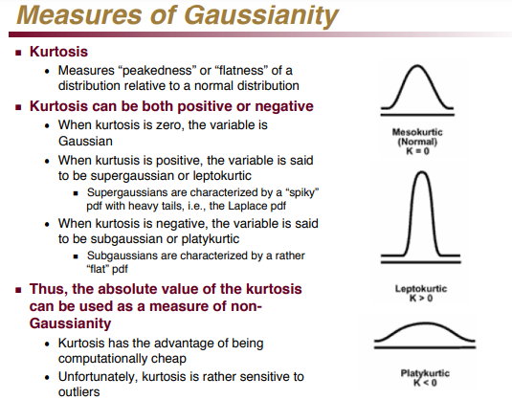
Independent component analysis

Slide 12
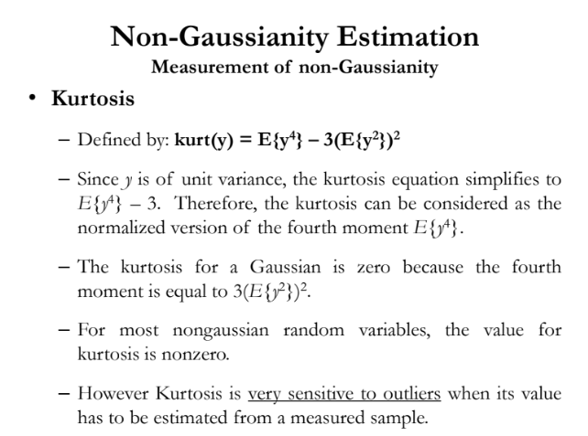
Independent component analysis
K1 and K2

Slide 13
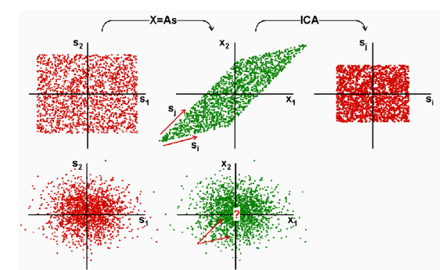
Independent component analysis
Source must be non-gaussian

Slide 14




Independent component analysis problem
Ordering problem: Don’t know the label
$$\left[\begin{matrix}a_{11} & a_{12} \\ a_{21} & a_{22}\end{matrix}\right]$$
$$\left({x_{1} \atop x_{2}}\right)$$
=
$$\left[\begin{matrix}a_{11} & a_{12} \\ a_{21} & a_{22}\end{matrix}\right]$$
$$\left({x_{2} \atop x_{1}}\right)$$
Scaling problem: Don’t know the actual scale for which make variance one by whitening the data

Slide 15
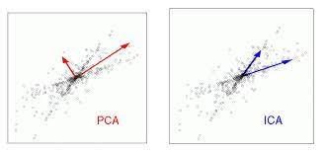
Independent component analysis
Difference

